Slide 1
Positive Regulators or Activators
A transcriptional activator is a protein that increases gene transcription of a gene or set of genes.
Most activators are DNA-binding proteins that bind to promoter elements.
To activate the transcription by the promoter, the activator helps polymerase enzyme to bind to the promoter.
Genes under positive control mechanism are expressed only when an activator or active regulator is present.

Slide 2
The system of regulation in lactose and tryptophan operon is essentially a negative control in the sense that the operon is normally “on” but is kept “off’ by the regulator protein.
In other words the structural genes are not allowed to express unless required.

Slide 3
Catabolic Repression by activators
Lac operon also shows positive control by catabolic repression.
In E. coli, in the presence of both glucose and lactose, the glucose in first fully utilized and then lactose is taken up for production of energy.
Glucose has an inhibitory effect on the expression of lac operon.
The mechanism of positive control enables E. coli to adapt more efficiently to the changing environment of its natural habitat.

Slide 4
In the presence of glucose, synthesis of β-galactosidase enzyme becomes suppressed.
The inhibitory effect of glucose is due to the marked drop in the level of a nucleotide called cyclic AMP (c-AMP), which inhibits the transcription of mRNA.
Lactose operon transcription requires not only cyclic AMP but also another protein called catabolic activator protein (CAP).
The cAMP and CAP form a complex called cAMP-CAP complex, which is necessary for the functioning of lactose operon.

Slide 5
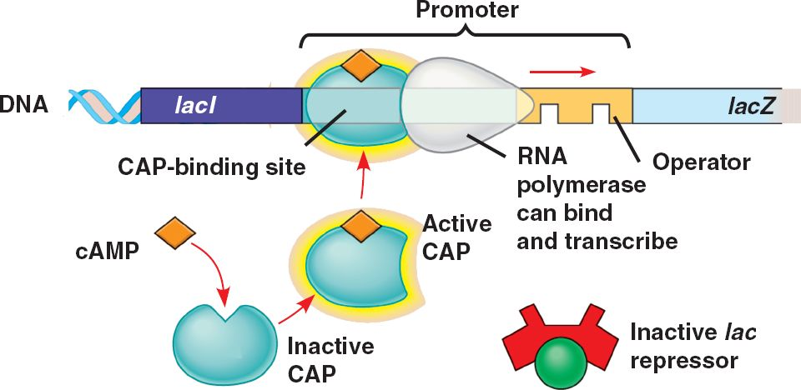

Slide 6
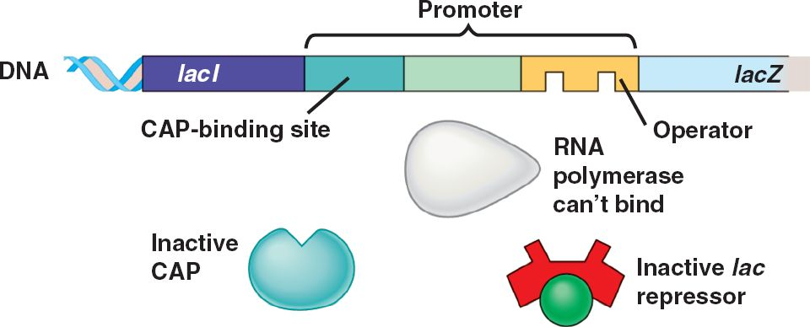

Slide 7
A catabolic breakdown product of glucose, called glucose catabolite, prevents the activation of lac operon by lactose.
This effect is called catabolic repression. When glucose concentration increases, the cAMP concentration decreases and vice versa.
High concentration of cAMP is necessary for the activation of lac operon.
Normally in the presence of glucose, the lactose operon remains inactive.
Glucose catabolite prevents the formation cAMP-CAP complex.

Slide 8
In this way cAMP-CAP system is positive control because expression of lac operon requires the presence of an activating signal which is this case in cAMP-CAP complex.
There are some promoters on DNA at which RNA polymerase cannot initiate transcription without the presence of some additional protein factors such as cAMP-CAP complex.
These factors are positive regulators because their presence is necessary to switch on the exons.
These are called activators or stimulators.

Slide 9
Arabinose operon
The L-arabinose operon, also called the araBAD operon, is an operon that encodes enzymes needed for the catabolism of arabinose in Escherichia coli.
It has both positive and negative regulation and is activated allosterically.
It has been a focus for research in molecular biology since 1970, and has been investigated extensively at its genetic, biochemical, physiological and biophysical levels.
In E. coli, arabinose is converted to xylulose 5-phosphate, an intermediate of the pentose phosphate pathway.

Slide 11
Structure
The structural genes, which encode enzymes for arabinose catabolism, are araB, araA, and araD (collectively known as araBAD).
The regulator gene is araC.
The genes araBAD and araC are transcribed in opposite directions.

Slide 12
araA encodes L-arabinose isomerase, which catalyzes isomerization between L-arabinose and L-ribulose.
araB encodes ribulokinase, which catalyzes phosphorylation of (L/D)-ribulose to form (L/D)-ribulose 5-phosphate.
araD encodes L-ribulose-5-phosphate 4-epimerase, which catalyzes epimerization between L-ribulose 5-phosphate and D-xylulose 5-phosphate.
D-xylulose 5-phosphate and D-ribulose-5-phosphate are metabolites in the pentose phosphate pathway.

Slide 13
The operators are ara O₁ and araO₂.
The operators lie between the AraC and CAP site.
AraI lies between the structural genes and the operator.
The araI and CAP are DNA-binding sites, which induce expression.

Slide 15
The structural genes (araB, araA, and araD) that encode the metabolic enzymes that break down arabinose are transcribed as a multigenic mRNA.
Transcription is activated at araI, the initiator region, which contains both an operator site and a promoter.
The araC gene encodes an activator protein that, when bound to arabinose, activates transcription of the ara operon, perhaps by helping RNA polymerase bind to the promoter, located within in the araI region.
An additional activation event is mediated by the same CAP–cAMP catabolite repression system that regulates lac operon expression.

Slide 16
In the presence of arabinose, both the CAP–cAMP complex and the AraC–arabinose complex must bind to the initiator region in order for RNA polymerase to bind to the promoter and transcribe the ara operon.
In the absence of arabinose, the AraC protein assumes a different conformation and represses the ara operon by binding both to araI and to a second operator region, araO, thereby forming a loop that prevents transcription.
Thus, the AraC protein has two conformations, one that acts as an activator and the other that acts as a repressor.

Slide 18
Function
Repression
The ara operon is regulated by the AraC protein.
If arabinose is absent, the dimer AraC protein represses the structural gene by binding to araI and araO₂ and the DNA forms a loop.
The loop prevents RNA polymerase from binding to the promoter of the ara operon, thereby blocking transcription.

Slide 19
Activation
When arabinose is present, arabinose binds AraC regulator protein and prevents AraC regulator protein from interacting.
This breaks the DNA loop.
The two AraC regulator protein - arabinose complexes bind to the araI₁ and araI₂ sites which promotes transcription.
When arabinose is present, AraC acts as an activator.
Also for activation the binding of another structure to araI is needed: CAP + cyclic AMP
So the activation depends on the presence of arabinose and cAMP + CAP complex.

Slide 20
